Slide 1
Battle of the neighborhoods
New York City vs. Toronto

Slide 2
Business problem to solve
Explore information of New York City and the city of Toronto; segmented and clustered their neighborhoods.
Choose a city of my own choice to open a restaurant.
In this project, I narrow down the goal to open a Chinese restaurant of a chosen city.

Slide 3
Objective
Collect neighborhoods information using Foursquare
Using k-means clustering algorithm to form clusters of the neighborhoods
Identify the similarities and differences between neighborhoods of New York City vs. City of Toronto
Make a decision for the better location to open a Chinese restaurant

Slide 4
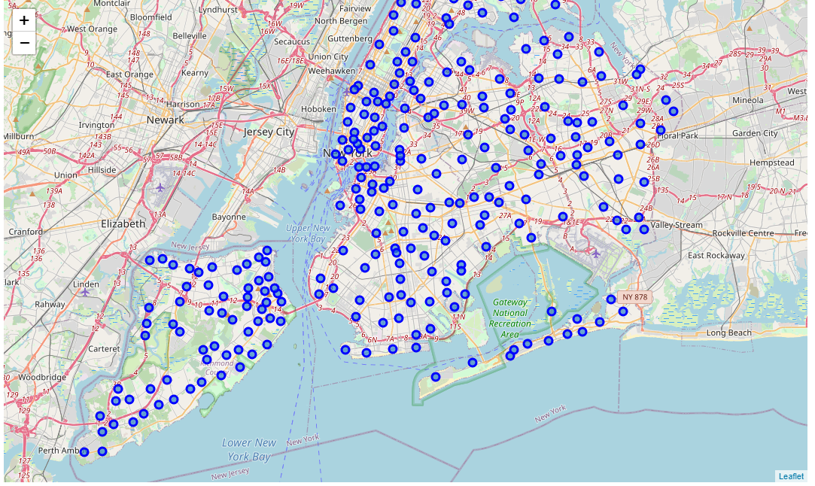
Map of New York City

Slide 5
Comparison between Neighborhoods
Toronto has 103 unique neighborhoods.
The most common venues in Toronto are Breakfast spot, pizza place, coffee shop, sandwich place and café.
New York City has 306 unique neighborhoods.
The most common venues in New York City are more diverse. I have clustered the neighborhood of Queens into 5 clusters:
Cluster 0: pizza place, deli, beach, hotel, etc.
Cluster 1: Deli
Cluster 2: Clothing store, restaurant, donut shop
Cluster 3: Gym
Cluster 4: Bakery, restaurant, park, bar, etc.

Slide 6
Conclusion
Based on the quantity and diversity of venues, New York City, especially the Queens neighborhood, is a better choice than Toronto to open a new Chinese restaurant. New York City has less restaurants to compete against, and there are more diverse venues such as gym, park, beach to attract more visitors/tourists, who might pay a visit to the new Chinese restaurant.

